Slide 1
Claim generation for Fact Verification Models

Slide 2
Outline
Introduction of the Fever Dataset
Creation of the FEVER Dataset
Baseline System Description
Evaluation
Transforming Question Answering Datasets Into Natural Language Inference Datasets (QA2D)
Team Papelo: Transformer Networks at FEVER
Better system for FEVER challenge
Entailment Module
Improvements Over Baseline
Evidence Retrieval Strategy
Zero-shot Fact Verification (+code explanation)
Overview
Evaluation
Results
Bibliography

Slide 3









Why?

Slide 4
Introduction of the FEVER Dataset (Creation of the Dataset)
FEVER (Fact Extraction and VERification) is a large-scale dataset for claim verification.
It consists of sentences that may be true or false, along with a set of documents that can be used to verify them.
The dataset was constructed in two stages described as follow:
Claim Generation
Claim Labeling (SUPPORTED, REFUTED or NOTENOUGHINFO)

Slide 5
Introduction of the FEVER Dataset (Baseline System Description)
Document Retrieval
Returns top k most relevant documents for a query using cosine similarity between binned unigram and bigram Term Frequency Inverse Document Frequency (TF-IDF) vectors.
Sentence Selection
Done by ranking sentences by TF-IDF similarity to the claim
Recognizing Textual Entailment
multi-layer perceptron (MLP)
Decomposable attention (DA) model in which training instances for the NEI class were simulated using:
NEARESTP method -> sampling a sentence from the nearest page.
RANDOMS method -> sampling a sentence at random from Wikipedia.

Slide 6
Introduction of the FEVER Dataset (Evaluation)
The best results were achieved using the Decomposable Attention (DA) model with the the NEARESTP method leading to an accuracy of:
31.87% where the evidence provided was correct
50.91% if the correctness of the evidence was overlooked

Slide 7
Creation of the QA2D Dataset
The QA-to-Claim Model used in the ‘Zero-shot Fact Verification by Claim Verification’ is a BART model that is finetuned on the QA2D dataset (where QA2D means to combine Questions and Answers into Declarative answer sentences)
The database has been created based on the already existing SQuAD dataset which contains pairs of questions and answers based on Wikipedia articles
A Q&A example consists of:
a text P.
a question Q related to the text.
an answer span A.
For each Q&A pair, a declarative sentence is generated, and based on entailment, an NLI example is then derived from the related Q&A example. Given the text passage P:
If A is a correct answer to Q, then (P,D) is an entailed NLI pair.
If A is an incorrect answer or Q cannot be answered using the information provided in P, then the sentence D is considered as not being implied by P, thus leading to (P,D) being a negative NLI pair.

Slide 8
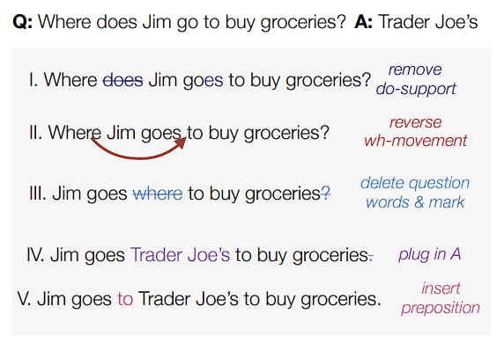
Creation of the QA2D Dataset (Sentence Generation)
3 methods were used to derive sentences from Q&A pairs:
A rule-based System relying on part-of-speech tagging (POS) and parsing accuracy.
Notable weakness Named entities with no articles
(Where does Sam work?/WHO) –> Sam works at WHO
(Where does Sam work?/UN) –> Sam works at the UN

Slide 9
Creation of the QA2D Dataset (Sentence Generation)
Crowdsourcing which would provide a collection of declarative sentences generated by humans. Participants were provided with:
Question-Answer pairs and asked to generate sentences from scratch in setup S
or
an output generated by the rule-based model for them to edit in setup E.
A neural sequence model trained with the dataset generated from the previous method to help overcome the rule-based system weaknesses.
Both the rule-based system and the neural sequence model performed relatively well but the latter had a slightly stronger overall performance.

Slide 10
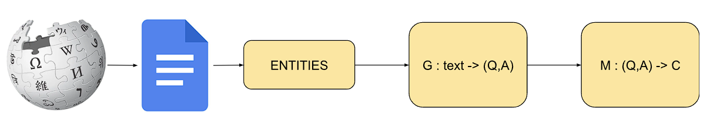
Zero-shot Fact Verification (Overview)
Sequence overview of the claim generation process:
(Q,A) : Questions and Answers generated from the passage
C : Claims are produced for each question
G : pretrained question generation model
M : pretrained QA to claim model

Slide 11
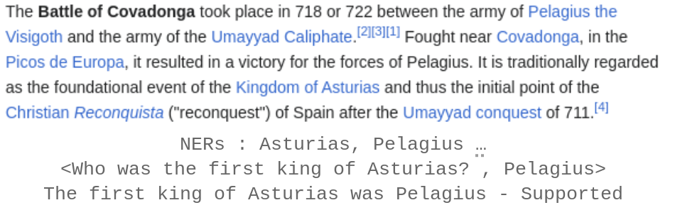
Zero-shot Fact Verification (Overview)
Input sample data are taken from wikipedia articles.
Named Entity Recognition (NER)
Question Generation
Claim Generation

Slide 12
Zero-shot Fact Verification (Named Entity Recognition)
Identifying and classifying entities (persons, organizations, locations…) within a given text.
Done using the Stanza's NER component
Example
Original Text: "Albert Einstein, a renowned physicist, was born on March 14, 1879, in Ulm, Germany."
NER Output: [(Albert Einstein, PERSON), (March 14, DATE), (1879, DATE), (Ulm, GPE), (Germany, GPE)]

Slide 13
Zero-shot Fact Verification (Question Generation)
Q&A pairs are generated from the evidence given a named entity as the answer using a pre-trained Question Generation (QG) model.
QG model is a BART model enhanced through fine-tuning on the SQuAD (Stanford Question Answering Dataset).
This model is designed to generate questions Q given input text D and answer entities A.
The results include pairs for each named entity, providing a set of questions that could be relevant to the given evidence.
Example
Input to QG: The output of NER for a specific piece of evidence.
QG Output: Generated (question, answer) pairs related to the identified entities.
"Who is Albert Einstein?" → "Albert Einstein is a PERSON."
“When was March 14 born?" → "March 14 is a DATE."

Slide 14
Zero-shot Fact Verification (Claim Generation)
Supported claims
NER → (q,a) → QA2D → Claim
Refuted claims
Answer Replacement: a (correct) → Sense2Vec → a_0 (incorrect)
Generating the Refuted Claim: (q,a_0) → QA2D → Claim
NEI claims
Additional context is extracted from Wikipedia using Stanza NLP.
QA pairs are generated based on this extended context using the QG model
QA2D is applied to produce claims.

Slide 15
Zero-shot Fact Verification (Claim Generation)
Example
Input to Claim Generation: Original evidence P along with the (question, answer) pairs generated by QG.
Claim Generation Output: Synthetically generated claims categorized as SUPPORTED, REFUTED, or NEI.
SUPPORTED Claim Example: "Albert Einstein is a renowned physicist."
REFUTED Claim Example: "Stuttgart is the birthplace of Albert Einstein."
NEI Claim Example: "In addition to Germany, Albert Einstein had connections to other countries."

Slide 16

Conclusion
Fast and efficient way of building models
Morality
Careful what you consider a “true” basis

